Slide 1
Secure Data Hiding in Images Using Steganography
CAPSTONE PROJECT
Presented By,
Student Name : M. Tarun
College Name : Agni College of Technology
Department : Computer Science and Engineering(CSE)

Slide 2
OUTLINE
Problem Statement
Technology used
Wow factor
End users
Result
Conclusion
Git-hub Link
Future scope

Slide 3
Problem Statement
With the increasing need for secure communication, traditional encryption methods often raise suspicion. Steganography provides a covert way to hide sensitive data within digital images, making it less likely to be detected. This project aims to develop a secure image-based data hiding system that enables users to embed and retrieve secret messages using password-protected steganographic techniques. The system ensures confidentiality while maintaining the image's visual integrity.

Slide 4
TechnologIES used
Programming Language: Python v3.13.2
GUI: Tkinter
Image Processing: OpenCV, NumPy
File Handling: OS Module
Steganography Method: LSB (Least Significant Bit) Modification
OS: Windows 11

Slide 5
Wow factors
This project stands out by integrating a user-friendly GUI for seamless image selection, encryption, and decryption, making steganography accessible to non-technical users. Unlike traditional cryptographic methods, it ensures undetectable data hiding by modifying pixel values without noticeable distortion. The use of lossless PNG images guarantees accurate message retrieval, overcoming the pitfalls of lossy compression formats like JPEG. Additionally, the system incorporates password-based access control, adding an extra layer of security to prevent unauthorized decryption.

Slide 6
End users
This project is designed for individuals and organizations that require secure and covert communication. The key end users include:
Cybersecurity Enthusiasts & Researchers – To explore and implement secure data-hiding techniques in real-world scenarios.
Journalists & Activists – To safely communicate sensitive information without raising suspicion.
Government & Intelligence Agencies – For confidential data transmission without detection.
Corporate Organizations – To protect intellectual property and internal communications from unauthorized access.
General Users & Privacy-Conscious Individuals – Who wish to keep their private messages secure while sharing images online.

Slide 7
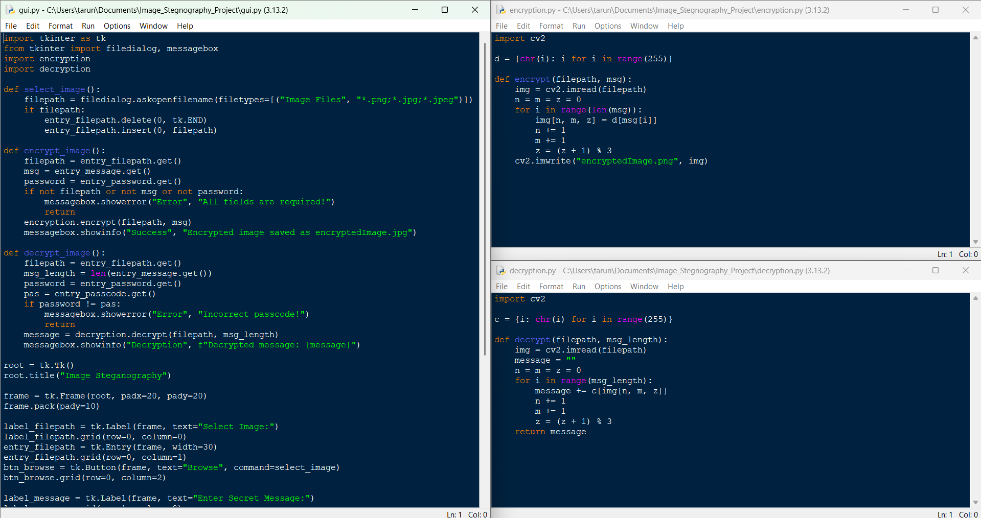
Results

Slide 8
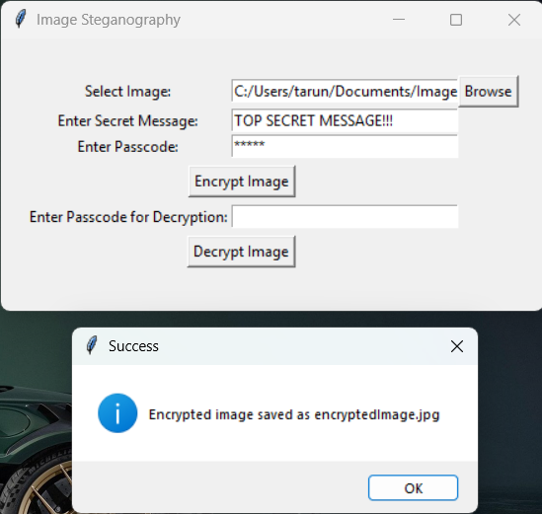
Results

Slide 9
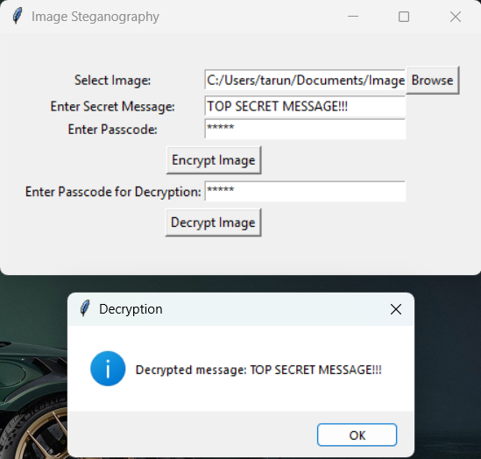
Results

Slide 10


Results
Normal Image
Encrypted Image

Slide 11
Conclusion
This project successfully implements secure data hiding in images using steganography, providing a covert way to transmit sensitive information while maintaining image integrity. By leveraging OpenCV, Tkinter, and lossless PNG encoding, it ensures accurate encryption and decryption without noticeable visual distortion. The integration of a user-friendly GUI and password protection enhances accessibility and security. Overall, this system serves as a reliable and efficient steganographic solution for secure communication in various fields.

Slide 12
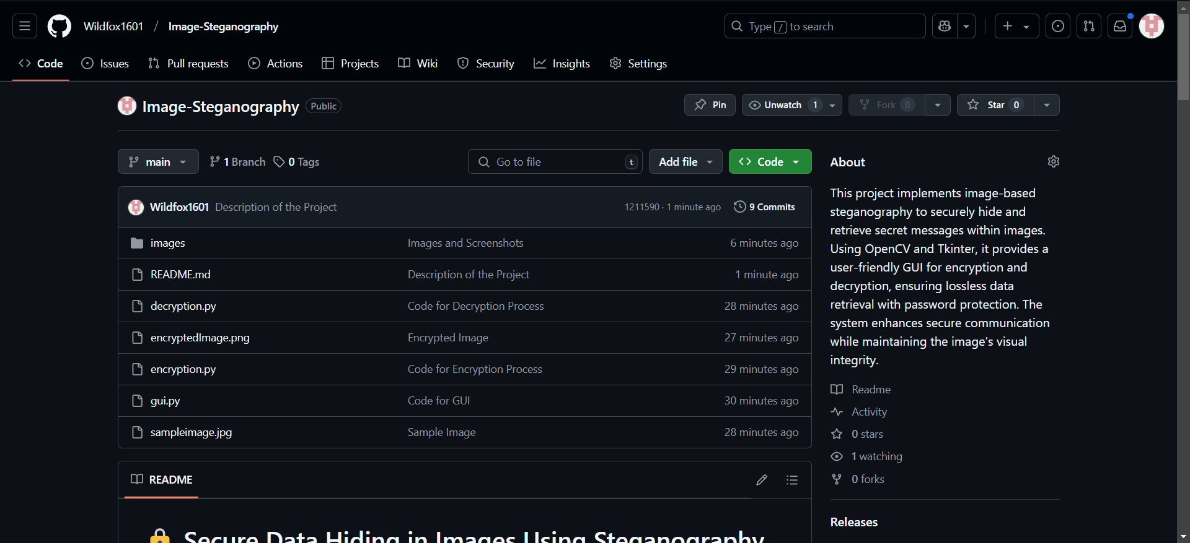
GitHub Link
Github Link - https://github.com/Wildfox1601/Image-Steganography.git

Slide 13
Future scope
Enhanced Security – Implementing advanced encryption techniques alongside steganography for double-layered security.
Support for Multiple File Formats – Extending compatibility to formats like BMP, GIF, and TIFF for greater flexibility.
Increased Capacity – Optimizing data embedding techniques to store larger messages within images.
Mobile & Web Integration – Developing a mobile app or web-based version for wider accessibility.
AI-Based Detection Prevention – Implementing adaptive steganographic techniques to evade AI-based detection systems.

Slide 14
THANK YOU!

